Slide 1
Lecture 10b.
Asynchronous Programming II

Slide 2
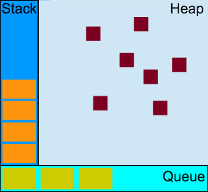
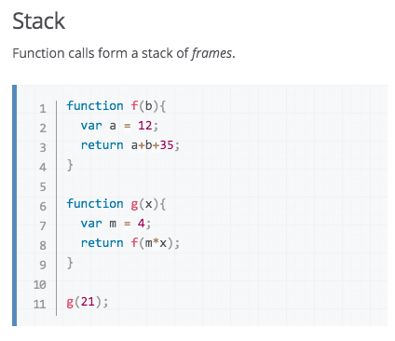



JavaScript is born in Async.
Heap accommodates objects.
Queue accommodates function calls to be process next.

Slide 3
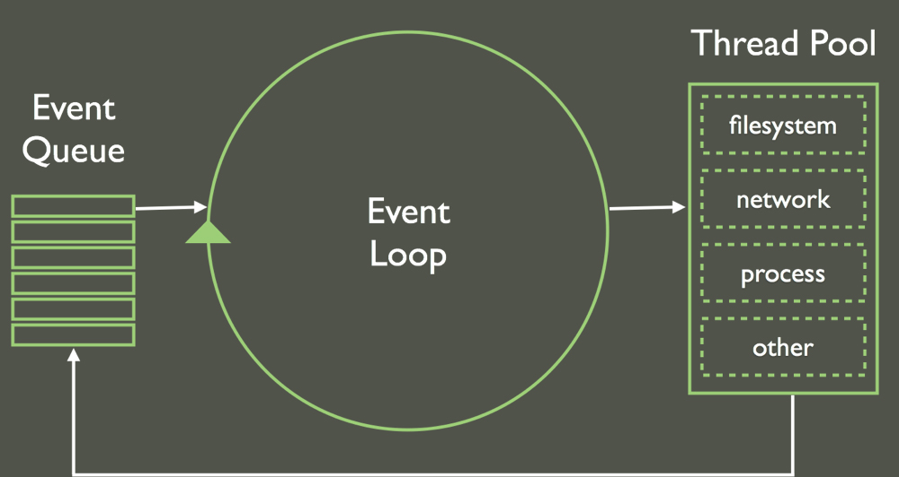
JavaScript is born in Async.
JavaScript is in a single thread

Slide 4
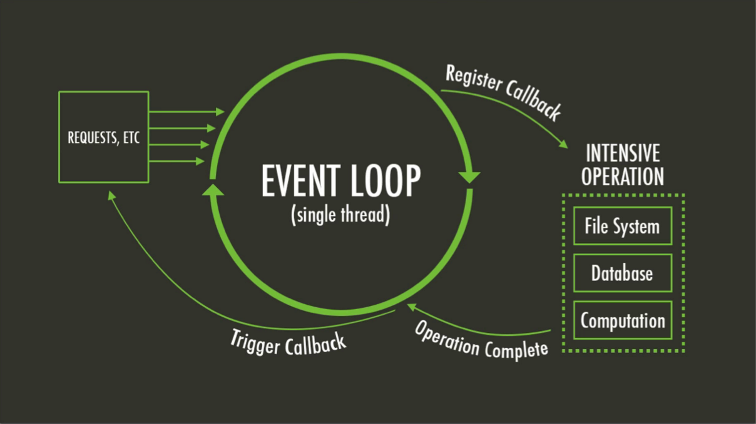
JavaScript is born in Async.

Slide 5
Asynchronous Programming
Style of AP
  callAysnc(param1, param2, callback)
  callback(error, result)
Traps of AP
  callback is the return of AP
  order of AP calls
    when need line-up calls, you have to wrap them in callbacks
  Once a async, all async
    when a call in a calling stack is async, all its caller ancestors are asyncs
  don’t throw error, callback error
  this will be lost, use closure instead

Slide 6
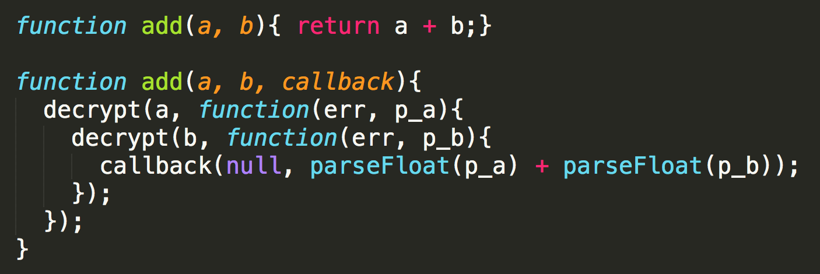
Async. example
CALLBACK HELL
callback is the return of AP
line up async calls in nested callbacks
once aysnc, all callstacks above aysnc

Slide 7
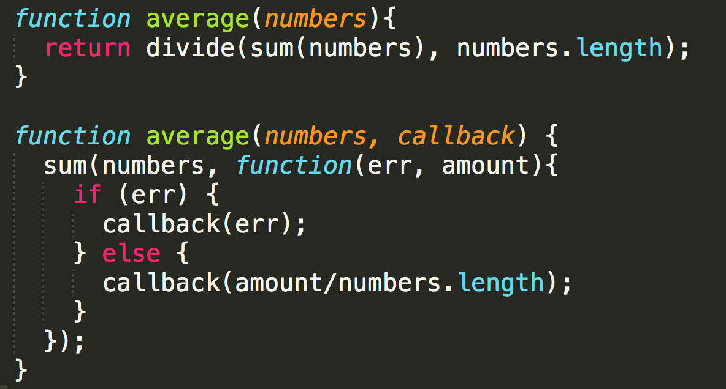
Async can be tricky
CALLBACK HELL
don’t throw error, callback error

Slide 8
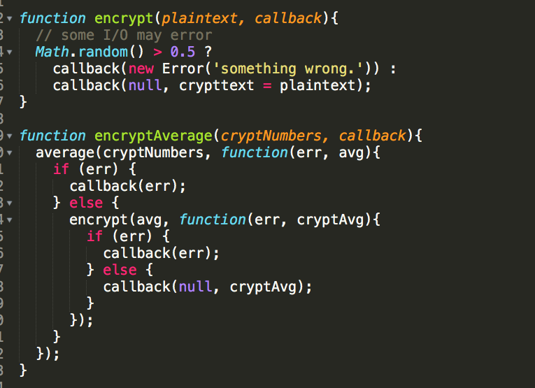
CALLBACK HELL

Slide 9
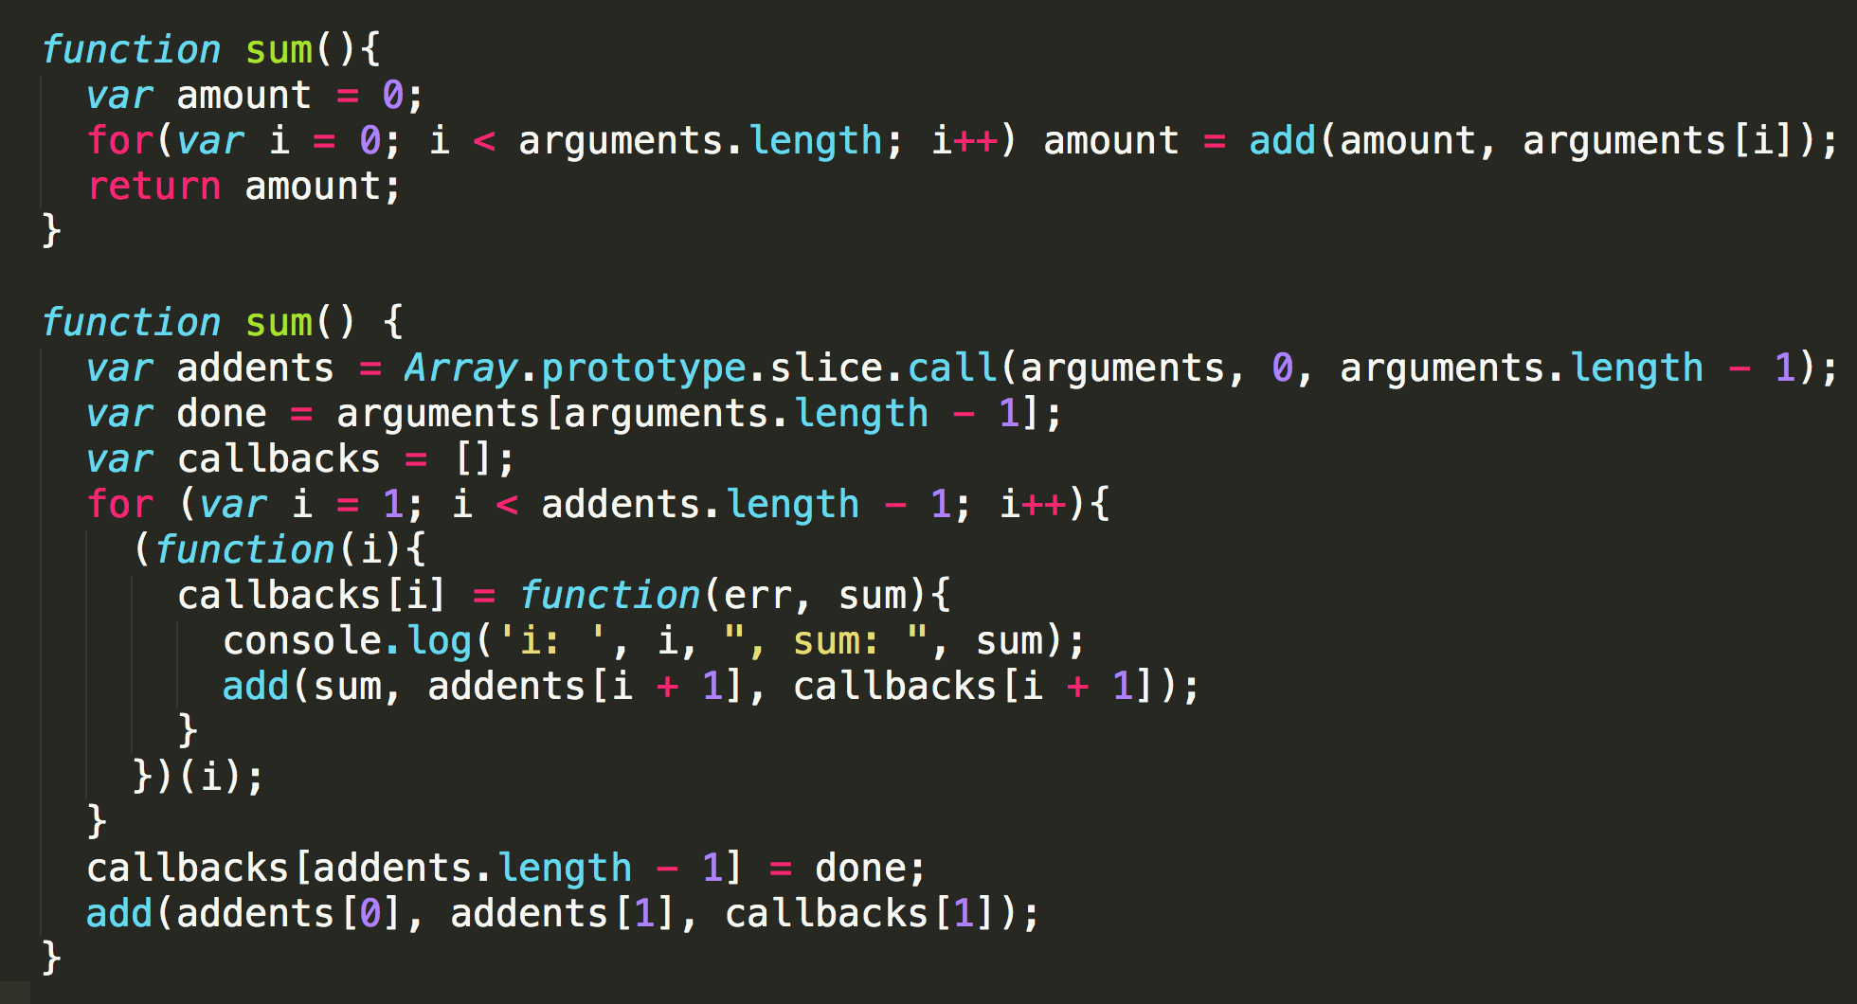
Async can be tricky
How about this with error handling in callbacks

Slide 10
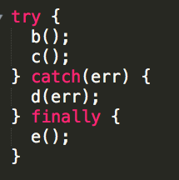
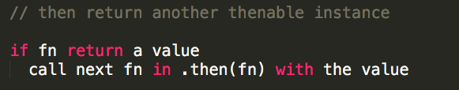

Thenable
thenable
then(fn)

Slide 11



Promise
...snow....
resolved
....days to Xmas...
...didn’t snow....
I promise you a white Xmas
rejected

Slide 12
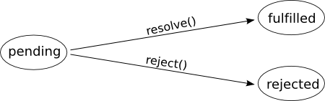
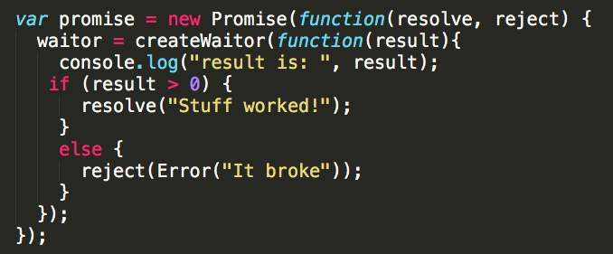
Promise

Slide 13
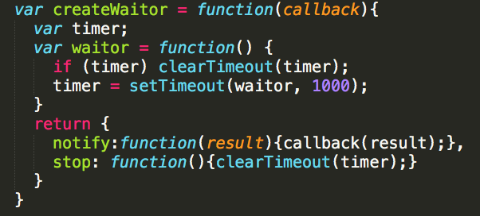
waitor

Slide 14
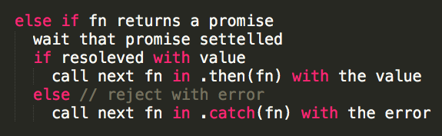
Promise is Thenable
thenable
then(fn)
http://www.html5rocks.com/en/tutorials/es6/promises/

Slide 15
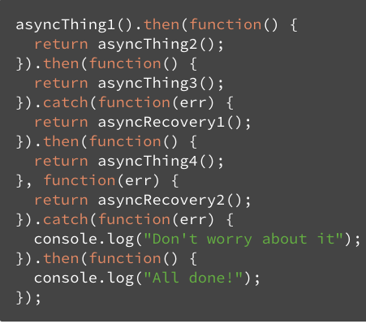
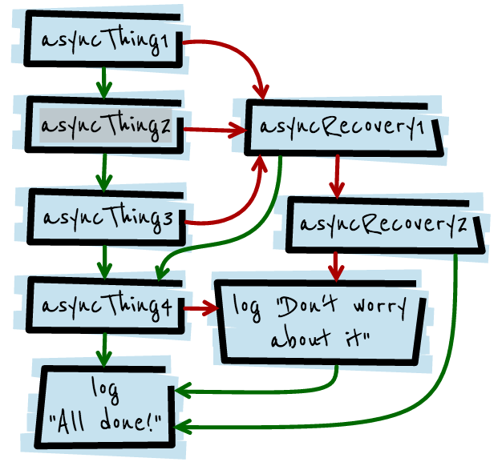
Promise is Thenable
http://www.html5rocks.com/en/tutorials/es6/promises/

Slide 16

Thank you!

